Slide 1
Banking Application
By
Sabbella.Vineetha

Slide 2
ABSTRACT
The program accepts the number of customers we
need to add and adds the customer and account
details accordingly. Further, it displays the series
of menus to operate over the account.
The series of menus displayed are as follows:
Display all account details
Search by account number
Deposit the amount
Withdraw the amount
Exit

Slide 3
APPLICATION DESCRIPTION
The Banking Application is an application for maintaining a person’s account in a bank.
The system provides the access to the customer to create an account, account type, search account, deposit /withdraw the cash from an account.
The following presentation provides the specification from the system.

Slide 4
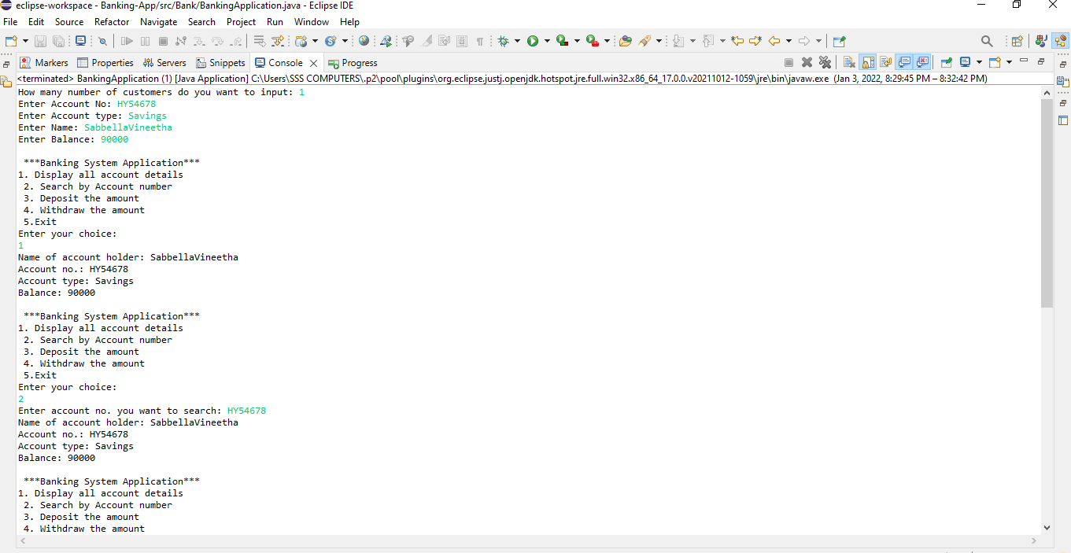
OUTPUT

Slide 5
Thank You

